Slide 1

INFINITE AI

Slide 3



Service Offerings Overview
Big Data and Cloud
Data Science
AI Ops
Collecting and processing of data for ingestion
Deep Learning, Computer Vision and NLP to solve business problems
Building enterprise-class infrastructure for seamless AI integration
Lightning fast data processing and real-time insight provision through distributed processing
Supervised and unsupervised ML algorithms to solve industry-specific use cases
Integrated Development, Deployment and Management infrastructure
Structured and unstructured data ingestion through a scalable data lake
Creating an efficient ecosystem through natural language understanding
Ability to process large volume of data using parallel processing
Expertise in the state-of-the-art Big Data and data preprocessing tools
Deep learning-based computer vision algorithms to gather insight from images
Deployment of AI solutions in production using DevOps framework

Slide 4

What to Expect

Slide 5

Decipher NLP Problem
Understand your dataset
Business Metrics
Baseline Models
Word Embeddings
Deep Neural Network Modelling
Code Base
To Dos

Slide 6

What Not to Expect

Slide 7
SOTA Results
Complete Dataset
Deep Learning as a Silver Bullet

Slide 8
Index
1. Problem Statement
3. Word Embedding
4. Recurrent Neural Network
5. Ensemble & Evaluation
6. Hands On
2. Naïve Solution

Slide 9


Problem Statement

Slide 10

A Recurrent Neural Pipeline
Build a Recommendation System, that can recommend Technology Domains & Tags for questions posted on Stack overflow.
Given a question in Stack-Overflow, predict the Technology Domain & Associated Tags for it.

Slide 11
Multi Class | Multi Label
Document
Politics
Election
Budget
Entertainment
Concert
Games
Movies
Player
Selection
Ban

Slide 12
Classification into multiple-classes which are independent & Labels which are not mutually exclusive in a hierarchical manner.
Question
Dev Ops
Jenkins
AWS
QA
Testing
Big Data
Selenium
Hadoop
Haskell
Docker
Apache Spark

Slide 13
Business Requirements
Precision-Recall Tradeoff
New Metrics
Inference Time
Frequency of Release

Slide 14

Understand Dataset

Slide 15
Exploratory Data Analysis
Understand Data Sourcing
How was the data collected
Biased data-collection technique
Complete or subset of original data
Data bias due to the problem or not ?
Understand Data Behavior
Word-Character Distribution
Time based Distribution
Class/Label Distribution

Slide 16
EDA Summary
Questions dataset : questions & related metadata for the questions from Stack-overflow
1.2mi documents
Tags dataset : Tags to the Questions in the previous file and are mapped via unique IDs
3.75mi tags
37k unique tags
Tag grouping dataset: 115 tags grouped in 14 groups
0.3% tags used as a filter
Retaining 44% Question-Tagging and 86% Questions
Above 40% Questions still multi-labelled
~3 tags/question reduces to ~1.5 tags/question

Slide 17
EDA Summary
Group | Group Name
1 | Programming
2 | MS-Development Environment
3 | Server-Side Development
4 | Mobile App Development
5 | Dev Environment
6 | Front-end/Designing
7 | Dynamic UI
8 | MVC
9 | Dev Ops
10 | Big Data
11 | QA
12 | Project Management
13 | Scripting
14 | Business Analytics

Slide 18

Naive Approach

Slide 19
Machine Learning with Bag of Words
Create
Master Vocabulary
Of all the words present in the document
Replace
Words with Numbers
Feed
To ML Model
Document-Label Pair to model
Based on Index in the Vocabulary

Slide 20
Create
Master Vocabulary
Of all the words present in the document
Create a unique list of all words we have, into a vocabulary.
Vocabulary are domain based e.g. medical based vocabulary very different from spoken English words. Consult SME what is important.
Data dependent. Suspectable to covariate shift.

Slide 21
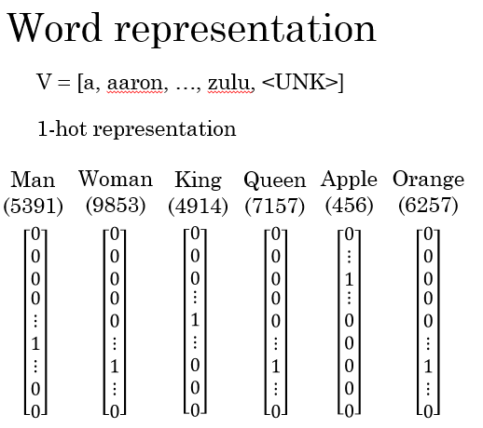
Words with Numbers
Replace
Based on Index in the Vocabulary

Slide 22
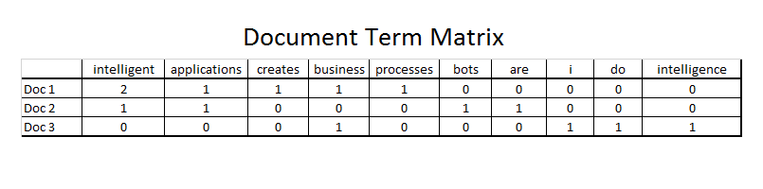
Words with Numbers
Replace
Based on Index in the Vocabulary
Notes
Frequency count based.
Term frequency–Inverse document frequency.
Sequence of words not conserved.

Slide 23
Words with Numbers
Replace
Based on Index in the Vocabulary
Points to ponder
Bag of words learns syntatic or statistical meaning of words
They are unable to learn the meaning of the word but know whether this word is present or not.
Lack of context and understanding
Context is the ability to inference based on what is around you which is clearly missing
Hence, they don’t understand as well, they identify patterns of text and inference based in that
Techniques like tf-idf are build the significance of a word based the documents avail, changing text will also alter the significance.
Where do we go from here ? Is there a way to build semantic understanding of text?

Slide 24
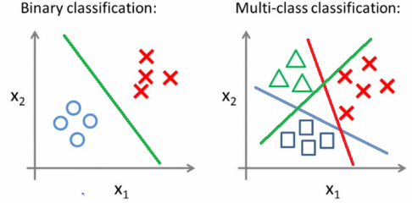
Document-Label Pair to model
To ML Model
Feed
We use a One v/s Rest strategy to learn a classifier for each Tag

Slide 25
Problems
Lack of context & understanding
Biasness towards certain words

Slide 26

Word Embeddings

Slide 27
What are Word Embedding?
Word embeddings are feature learning techniques in NLP where words or phrases from the vocabulary are mapped to vectors of real numbers.
Frequency based Embedding
Count Vector
TF-IDF Vector
Co-Occurrence Vector
Prediction based Embedding
CBOW (Continuous Bag of words)
Skip – Gram model
Transformers acrhitecture are leading the research front

Slide 28
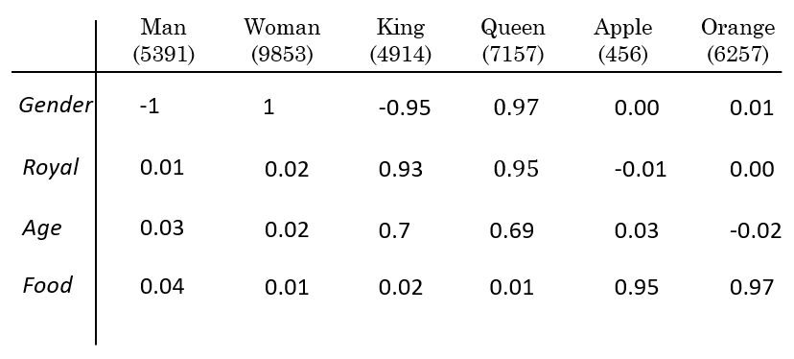
Words with Numbers
Embeddings
Based on Index in the Vocabulary

Slide 29
Why do we need them?
ML algorithms and almost all Deep Learning Architectures are incapable of processing strings or plain text in their raw form.
To represent human understandable language to binary machine codes
Better representation leads to better machine understanding

Slide 30
Pipeline

Slide 31
Word Embedding
Data
Pre-processing Text
Bag of Word
SOTA Embeddings
Custom Embeddings

Slide 32
Data Preparation
Data
Training Format
Single Dataset
Pre-processing Text
Multiple Dataset
Standard Division
Normalised Division
Single Model
Model Forest
Model Forest

Slide 33

Neural Networks

Slide 34
Why Recurrent Neural Network
Preserving context of documents
Sequence of paragraphs & contents matters

Slide 35
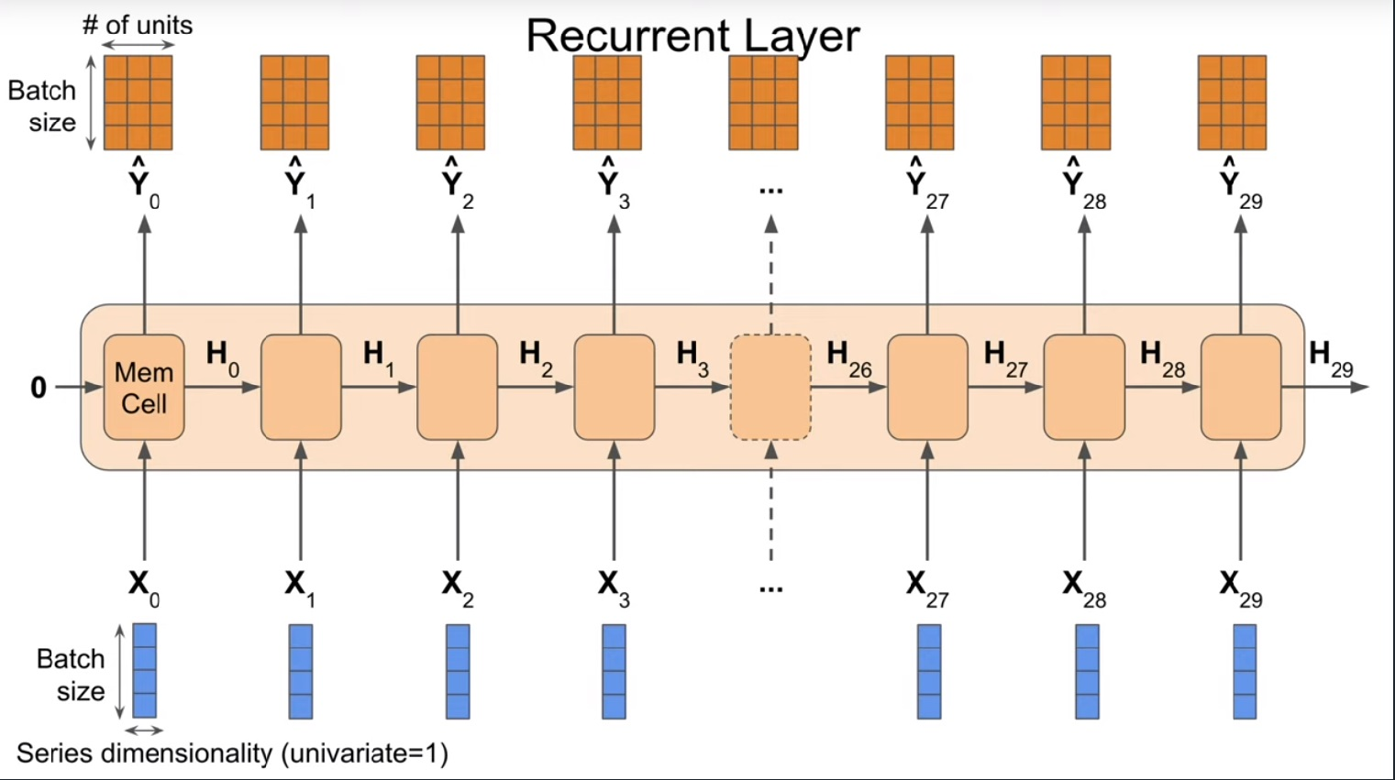
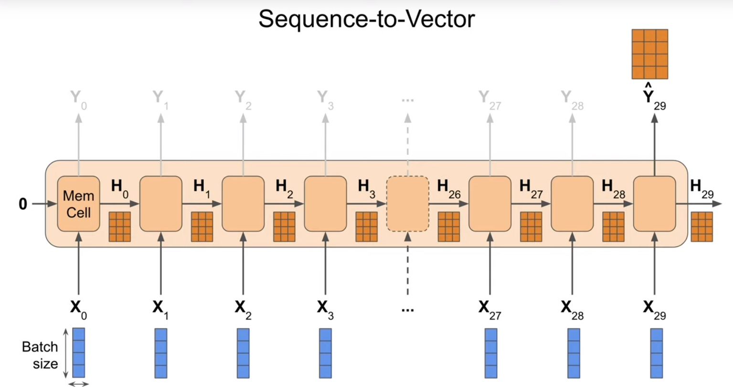
Recurrent Neural Network
Every word is an input at a time-step
Hidden State from previous time-step

Slide 36
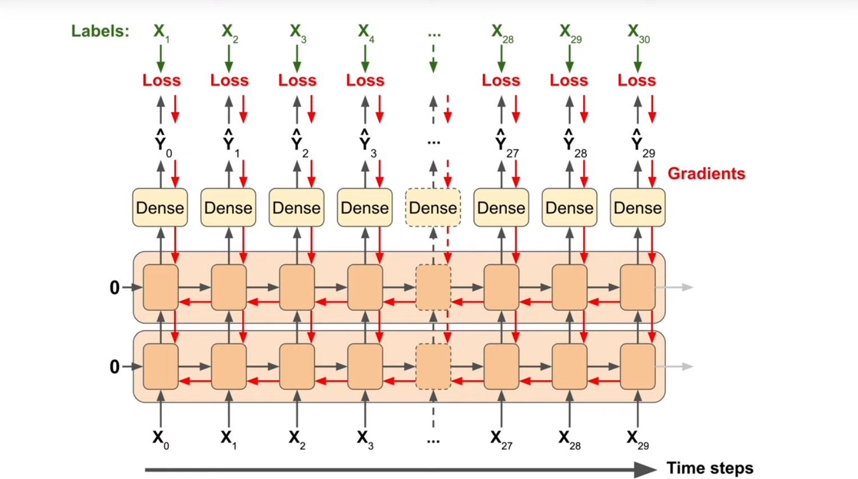
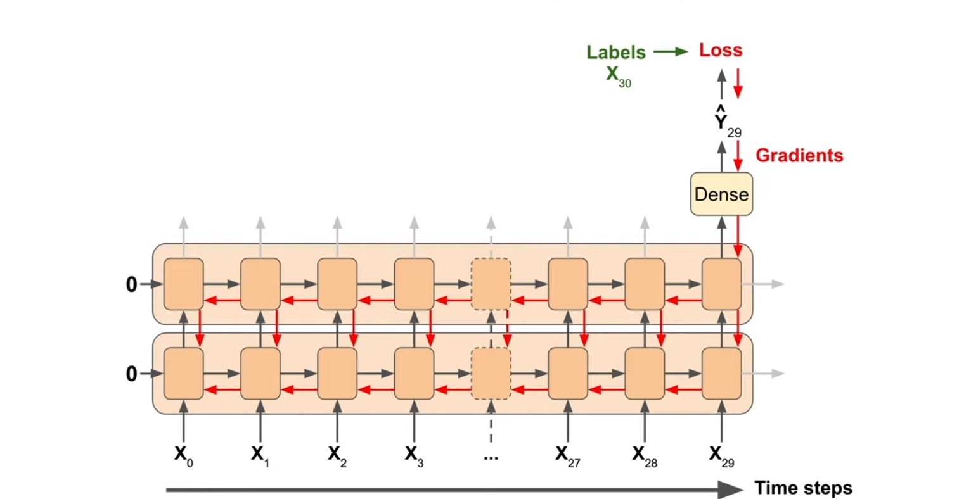
Backpropagation Through Time
Seq-Vec : Gradients from the last-step is propagated
Seq-Seq : Gradient at each time-step is propagated

Slide 37
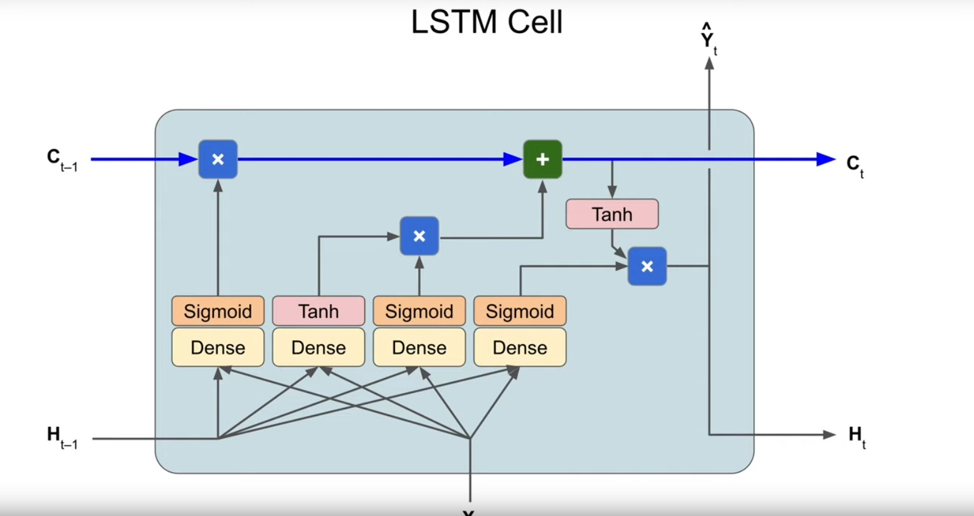
RNN Cell

Slide 38
Parameters
word_embeddings: The Embeddings that we want to stack
hidden_size : Sequence Length for rolling over time
rnn_layers : Number of RNN cells to be stack. Decides how deep the network is
bidirectional : Decides whether the models reads the sequence from Left/Right/Both
reproject_words : Decides whether we want to retune the word embeddings
reproject_words_dimension : Embedding dimension after retuning.
dropout : Dropout to be used
rnn_type : Type of RNN Cell to be used

Slide 39

Challenges with RNN
Sensitive to lr & batch size
Training Loss unstable
Hard to Train
Early stopping may lead to dumb model
High patience level
Need to train for longer
Seq-Seq are better than Seq-Vec

Slide 40
Single Model
Question
Jenkins
AWS
Testing
Selenium
Hadoop
Haskell
Docker
Apache Spark

Slide 41

Our Model
Stacked Document Embeddings.
Multiple Pre-trained and custom trained(by us) word embeddings stacked.
Enables capturing different relations & features in the document.
Project the embedding to a trainable embedding layer. Enables fine-tuning for down-stream/explicit task.
Model
LSTM
2 Layers
64Hidden Items (Rolling over time)
256 dimension embedding reprojection

Slide 42

Ensembled Neural Networks

Slide 43
Multi Class | Multi Label
Question
Dev Ops
Jenkins
AWS
QA
Testing
Big Data
Selenium
Hadoop
Haskell
Docker
Apache Spark

Slide 44
Re-Designed Model
Improved Average Coverage by 17% by just changing to Ensembled models.
Trade-off with inference time & memory utilization.
Possible expansion to ensembling on each category.
Business Impact :
Slower Inference
Scalable Training
Scalable to more domains

Slide 45
Re-Designed Model
Ensembled Model of Categories
Helped in Class imbalance. Alternative to Bootstrapping.
Flexibility to set Threshold.
Flexibility for Hyper Parameter tuning differently.
Negative Sampling for different classifiers.

Slide 46
Take Away
Single Deep Learning Models are not a silver bullet solution to problems.
Ensemble Models can be used to sub-divide the problems and reduce complexity.
Case-sensitivity in models and embeddings are important factors to be taken into consideration.
Data augmentation/extrapolation leads to increased False Positive apart from generalizing the model.
Recurrent Neural Networks needs to be trained cautisouly.

Slide 47

Questions

Slide 48
Contact
Amit Agarwal
Email : amit.agarwal@abzooba.com
GitHub : https://github.com/amitbcp
LinkedIn: https://www.linkedin.com/in/amitagarwal6/
Ishant Wankhede
Email : ishant.wankhede@abzooba.com
GitHub : https://github.com/IshantWankhede
LinkedIn: https://www.linkedin.com/in/ishantwankhede/

Slide 49
Thank You

